Slide 1
Picture Connector

Slide 2
Picture Connector
4 pictures would be displayed
The pictures may seem no way connected to each other.
In spite of this, you should be able to link all the given pictures

Slide 3
Picture Connector
First, come up with a theme for a story.
Secondly, with the selected theme,
you need to structure a sequence of twists and turns in the story ,that are related to mentioned characters and plots,
Finally you must come up with a moral of the story

Slide 4
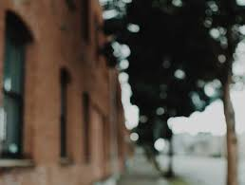

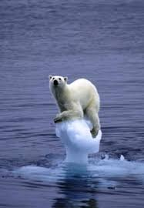
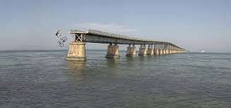

Slide 5
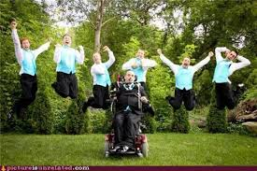
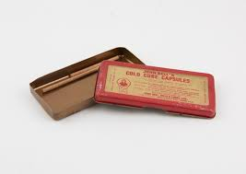
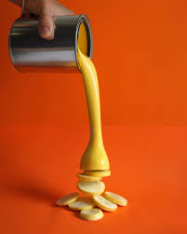


Slide 6
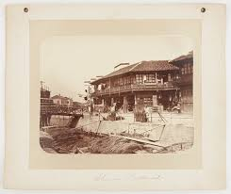
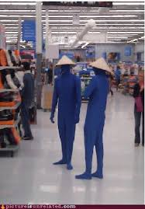
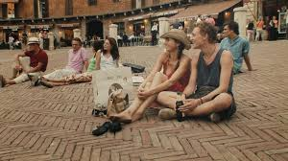


Slide 7


